Slide 1
Preparing for the Interview
Watch this presentation, then connect with us for a live Q & A
on Monday, September 23, 2019 from 4:30-6:00 p.m.

Slide 2
Before the Interview:
Personal Preparation

Slide 3
Taking Stock of Who You Are
What are my strengths?
What previous experiences will assist me in the position?
What special or unique skills can I offer?

Slide 4
Face to Face with Your Online Presence

Slide 5
To Portfolio or not to Portfolio?

Slide 6
What to Include in a Portfolio?
Brief Biography
Faith Connections
CV/Resume
Reference Letters
Projects/Articles/Presentations that you have authored
Photographs that support your work
Extra Curricular Engagements
Education & professional development Information
Lesson & Unit Plans that you have developed

Slide 7
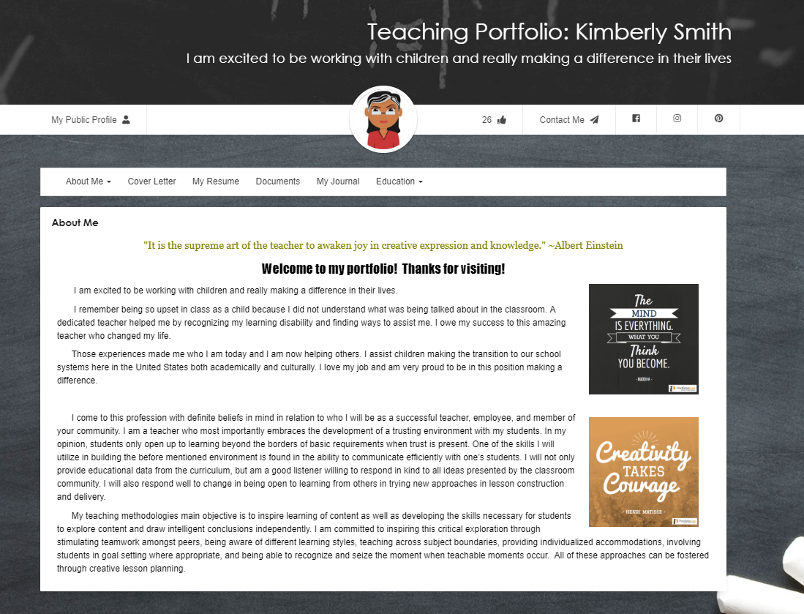
Preparing for the Interview
Are you interested in previewing a digital teacher portfolio? Click on the image to the left.

Slide 8
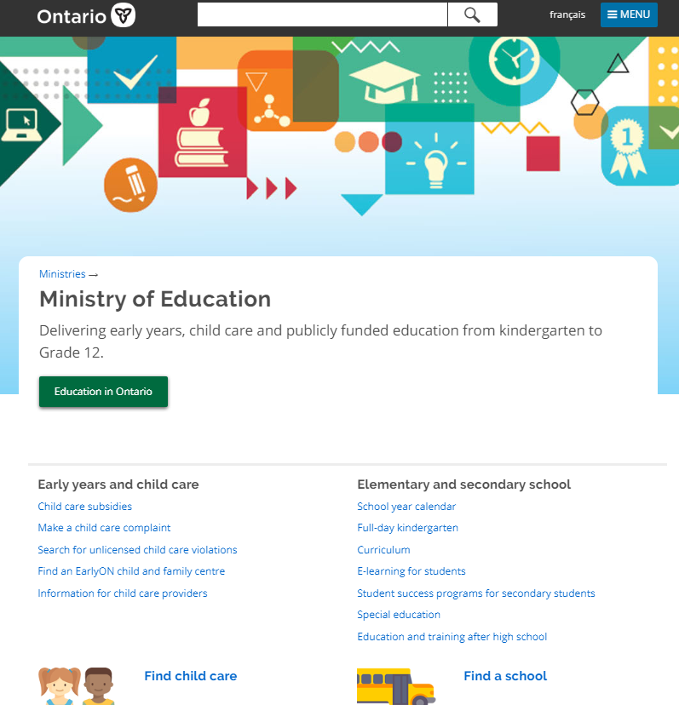
Do Your Homework
Familiarize yourself with new or pertinent Ministry initiatives, documents, legislation, PPMs or other education sector support documents pertinent to the position
Visit MOE website

Slide 9
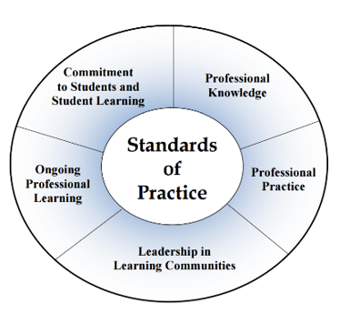
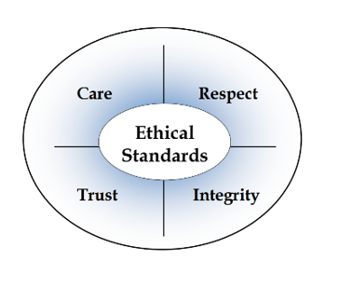
OCT Standards of Practice
http://www.oct.ca/public/professional-standards/standards-of-practice
OCT Ethical Standards of Practice
http://www.oct.ca/public/professional-standards/ethical-standards

Slide 10
Get the ‘School Scoop’!
School Priorities?
School Newsletter?
Key Initiatives?
School Improvement Plan?
Community & School Demographics?
Local Church?

Slide 11
Preparation is Key

Slide 12
The Interview Timeline
30 to 40 minute interview
4 to 6 questions are asked
5-7 minutes allotted for each response

Slide 13
Interview Questions

Slide 14
Question Topics/Themes
Catholicity / Faith Development
Classroom Management
Curriculum
Assessment & Evaluation
Special Education
Conflict Resolution / Collaboration & Self-Awareness
21st Century Learning / Technology
Equity & Inclusivity
Extracurricular

Slide 15
Faith Development
How will you integrate your Catholic faith in your classroom and school?
How is the Catholic School system distinct from the public school system and how will you help our students grow in faith?
Consider the role of Catholic teachings and Gospel values across the curriculum
Modelling of Catholic values and virtues
Catholic graduate expectations
School, Parish connection
Role of sacraments

Slide 16
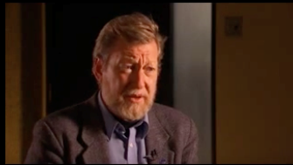
Faith Development Supports
The Enduring Gift

Slide 17
Classroom Management
What is classroom management and how will you achieve it?
Consider how your preparedness impacts student engagement
Consider how you build a sense of community in your classroom among students
Consider how routines and rules are established
Consider how do you handle inappropriate student behaviour
Consider the impact of punishment versus consequence, preserving dignity
Consider board/school policies pertaining to progressive discipline
Parent communication and consultation with colleagues

Slide 18
Classroom Management Supports
Classroom Management
Classroom Management

Slide 19
Curriculum
What steps would you take in planning? (day, unit, lesson, subject)
Curricular documents and additional support documents
Integrated curricular opportunities / Catholic lens
Available resources (texts, materials within the school, websites)
Collaboration with colleagues
Design-down model
Inquiry
Differentiated Instruction
Student Learning Styles
Identified Needs (IEPs) (accommodations and enhancements)
Assessment & Evaluation (for, as and of learning, descriptive feedback)

Slide 20
Curriculum Supports
Curriculum Supports

Slide 21
Assessment & Evaluation
Describe your assessment and evaluation practices? (i.e., what you use, how they inform your instruction and how they are used for reporting)
Assessment for, as and of learning & examples
Identify various assessment strategies
Learning Goals and Success Criteria
Descriptive feedback
Differentiated Instruction (content, process, product, environment)
How a term grade is generated

Slide 22
Assessment & Evaluation Supports

Slide 23
Special Education
How will you know when to initiate the special education process for a student and what will you do?
Steps to undertake when there is a concern about a student
Ongoing parent communication
Strategies to support all learners
Role of differentiation
School team outreach
Individual Education Plan
Accommodation versus Modification

Slide 24
Special Education Supports

Slide 25
21st Century Learning / Technology
How has technology impacted your teaching practice? How do you use technology in your classroom? What role does technology play in your role as a teacher?
Speak from a position of knowledge
Know where the board/school is at with technology (programs/resources available)
Discuss professional development
Know the board/school policy pertaining to PEDs/BYOD
What technologies have you implemented and for what purpose
Be able to speak to the importance of global citizenship education
Provide examples of the of technology in teaching and learning

Slide 26
Conflict Resolution, Collaboration & Self-Awareness
How would you handle a conflict involving a parent or colleague? Explain the steps you would take to resolve the conflict.
Maintaining professionalism at all times
Importance of confidentiality
Attentive listening, open mind, objectivity
De-escalation
Consultation
Consider how will you prepare to resolve conflict (talk to previous teacher, a colleague, consult with admin, review OSR)
Demonstrate respect in responding
Consider follow-up, next steps or possible changes that can mitigate future conflict
Accept responsibility

Slide 27
Words are not enough…
Your understanding of pedagogy and best practices will be demonstrated by the vocabulary you utilize
You need to show evidence of application of pedagogy in your practice
Your answers must reveal in-depth understanding of the topic

Slide 28
A Model for Preparing Responses Snow person model I believe… It looks like… In my classroom…

Slide 29
Let’s Practice
How do you address classroom management?
I believe that classroom management is as much about teacher preparation as it is about student behaviour.
I also believe that it is the key to student learning.
As an educator, if you do not have strong and effective classroom management skills you will not be effective in your instruction or assessment, amongst other things, and students will not be engaged or on task.
What do you believe?

Slide 30
Let’s Practice
How do you address classroom management in your classroom?
Classroom management involves many pieces working together, it is not just about one thing.
It is both about teacher preparedness and about managing student behaviour.
In order to have effective classroom management you need to consider the various factors that lead to effective classroom management.
What does it look like?

Slide 31
Let’s Practice
How do you address classroom management in your classroom?
I remember to differentiate content, process and product. I keep in mind student interests, flexible groupings and respectful tasks. To unpack this, some factors that lend to effective classroom management include:
Classroom organization – environment as “the third teacher”
Curriculum planning, long range and daily
Differentiation – meeting student learning needs
Establishing routines & rules
Building and maintaining professional and positive student relationships
The importance of understanding behaviour
Applying varied behaviour management strategies
What does it look like?

Slide 32
Let’s Practice
How do you address classroom management in your classroom?
In my classroom, classroom management begins long before school starts in September. In order to be prepared a great deal happens behind the scenes in terms of planning. For me, I begin with planning the functionality of my classroom environment. In doing so, I consider access to resources, space for varied groupings, and tools for support and guidance, such as anchor charts and success criteria. Visual cues are also important to support student learning. I always have an agenda composed of words and pictures to help my students know what’s planned for the day. I use the same tool to highlight changes in routine so students are prepared rather than surprised. Access to resources and materials can also help to mitigate disruptions, so I always have materials available to students in various areas around the room. I believe that preparing a functional environment is a very important part of creating a successfully functioning classroom.
How have you demonstrated this?

Slide 33
Let’s Practice
How do you address classroom management in your classroom?
Preparing curriculum is important. I create long range plans and keep detailed daily plans that I amend as needed. Being prepared increases my ability to function optimally and keeps my students engaged because I can respond to their learning needs. I also use varied instructional and assessment strategies to keep my students present and focused.
Building relationships is also necessary. Getting to know my learners supports interpersonal relationships, builds trust, and helps me to better understand my students as individuals. Fostering relationships among students is also important because I aim to have my students treat all their classmates with respect. Much of this is accomplished through the TRIBES program which fosters co-operative learning.
Getting to know my students as learners is also important because it helps me to be more effective in my differentiation. As we know, differentiation is important for engaging students and maximizing learning outcomes.
How have you demonstrated this?

Slide 34
Let’s Practice
How do you address classroom management in your classroom?
Consistency is another crucial element of classroom management. As the teacher I need to stick to my classroom routines and rules, but I also need to be flexible.
Inappropriate behaviour is inevitable. It will happen. For myself, its important to try to determine the ‘why’ of the behaviour because often that will provide insight into the best way to respond to the behaviour. For example… (Provide an example.)
Dealing with the behaviour rather than the student is important for maintaining a positive relationship and preserving student dignity. Its also important to have a number of strategies on hand because what works for one student might not work for another. When it comes to managing behaviour, prevention and de-escalation are key. As I mentioned, understanding the ‘why’ behind a behaviour is also crucial. In extreme circumstances I may need to consult my administrator or colleagues for support.
How have you demonstrated this?

Slide 35
Let’s Practice
How do you address classroom management in your classroom?
Establishing routines and rules at the onset of the school year in partnership with my students gives them a sense of ownership and responsibility for their actions and behaviours. It enables student buy-in because they created the expectations and, as such, they have responsibility in monitoring compliance. My students work in groups to create a list of rules that focus on positive statements rather than “don’t” statements.
Sometimes it will be necessary to implement a consequence, however it is important to respond appropriately and in keeping with progressive discipline. This means ensuring that the consequence is age-appropriate and aims to correct behaviour rather than punish.
How have you demonstrated this?

Slide 36
For Success

Slide 37
Dress Code Applies: Image & Presentation
Know where you are going and arrive on time
Smile, speak positively, check body language
Choose the right interview clothes

Slide 38
What You Wish You’d Known Before…

Slide 39
Join us for a LIVE Q & A on Monday, September 23, 2019 from 4:30-6:00 p.m. Register at: www.catholicteachers.ca

